Slide 1
Projection Mapping challenge

Slide 2
Projection Mapping
Projection mapping is the art of liberating video content from the confines of flat screens.
By transforming irregular surfaces—such as buildings, objects, or stages—into dynamic video displays, we can create the illusion that these objects are moving, changing shape, or coming to life.

Slide 3
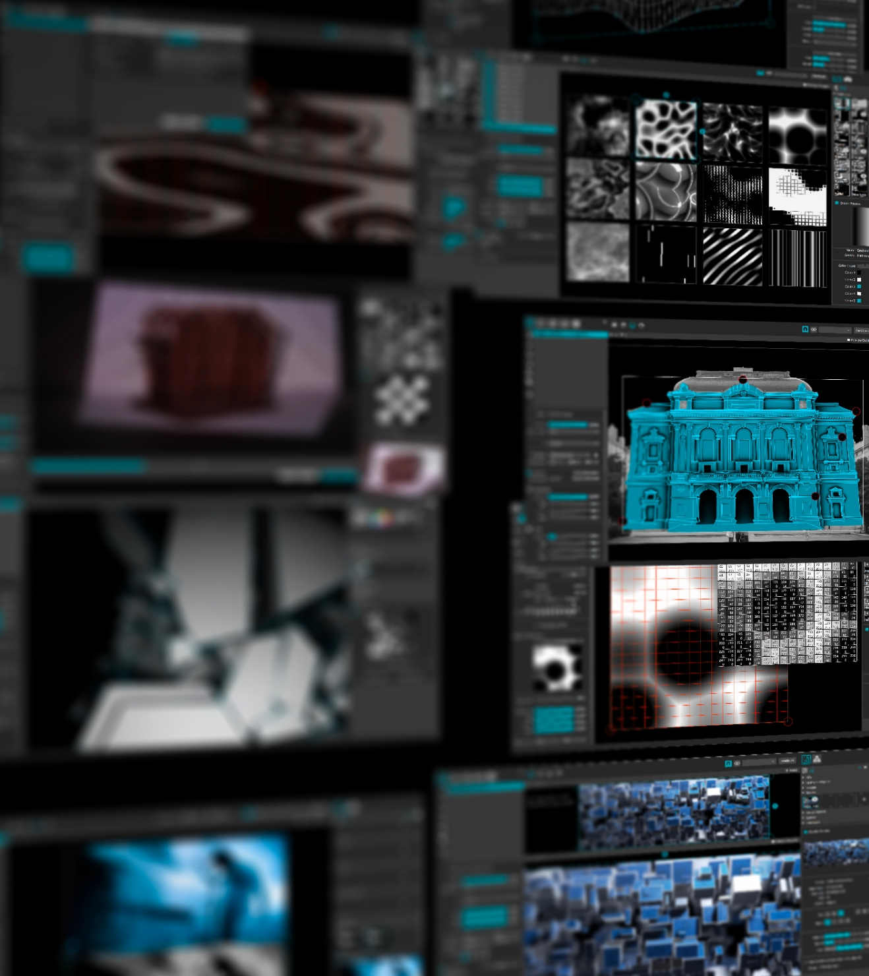
MadMapper

Slide 4

Set the projector right
Make sure all your projection surfaces are “seen” by the beamer

Slide 5
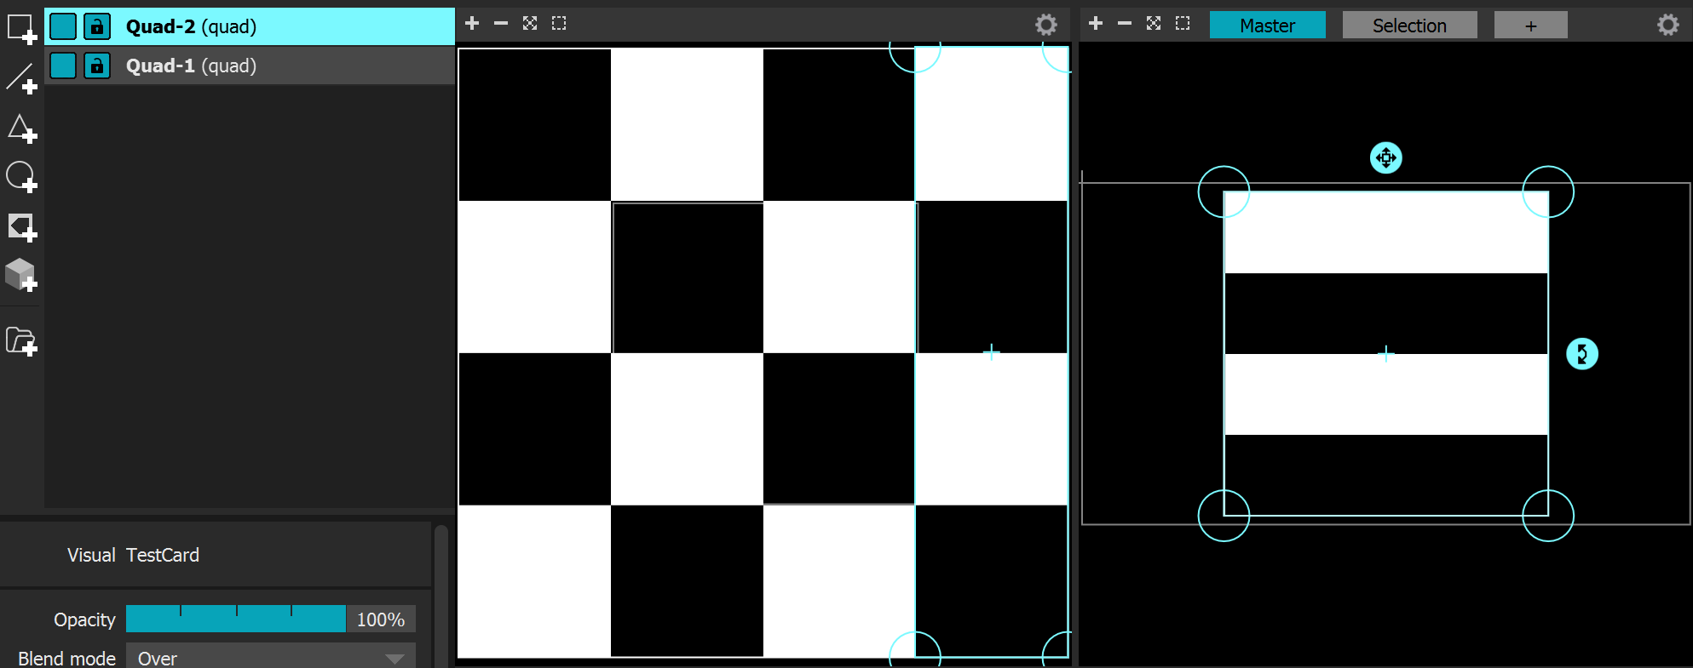
Set up basic surfaces
Create quads for each surface where you would like to project. And map them accordingly

Slide 6
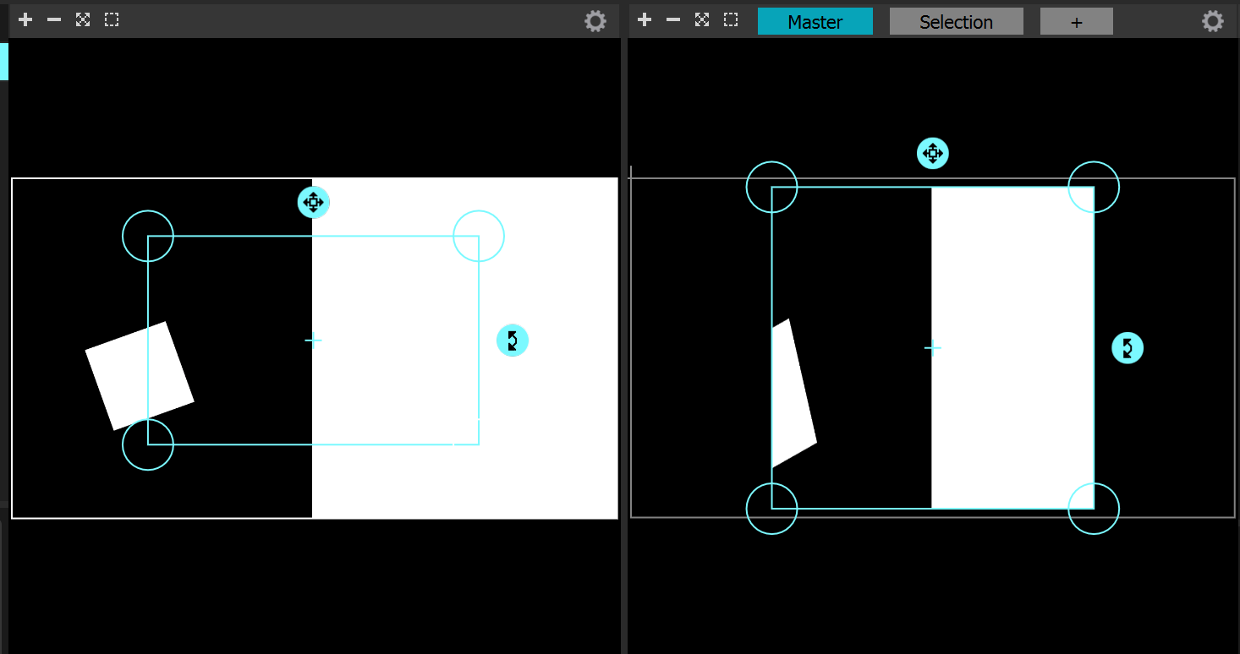
Add content
Add content a refine accordingly

Slide 7
Challenge
Bring a 3d/spatial element to your content by projecting on the props that you brought some of the objects in the room.
Keep in mind how can you make the spatial element and your video enhance each other.
Present on 15:00

Slide 8

Thank you

